Slide 1
Summer of Computational Imaging
CIG - Instructor Name, Aayan Goyal

Slide 2
Intro & Overview

Slide 3
Instructor Intro
Instructor intro

Slide 4
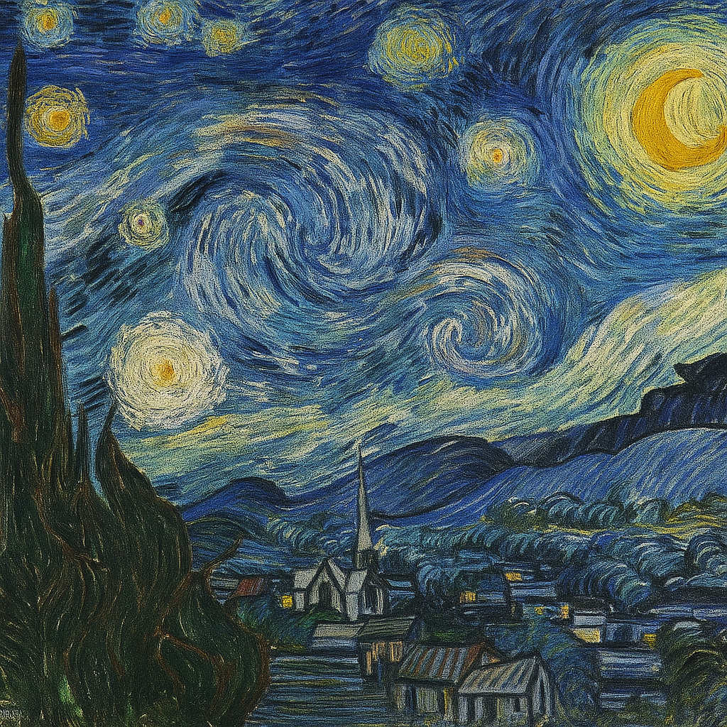
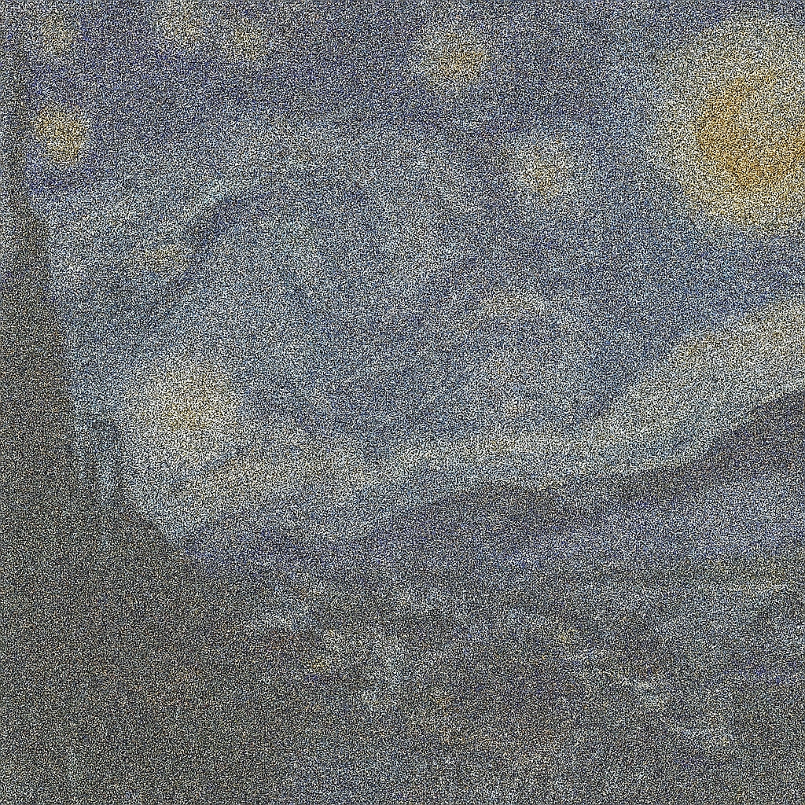
Let’s say that Starry Night got super messed up–it got super “noisy”

Slide 5
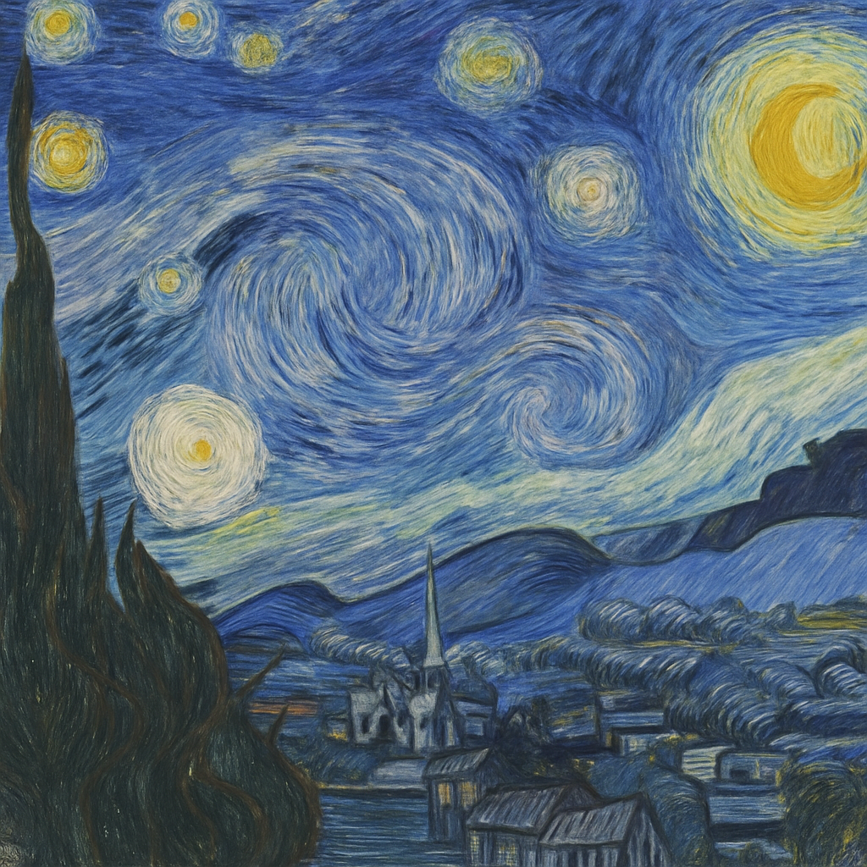
The power of denoising
Using an algorithm, we can remove all that noise–we can denoise–the image and turn it back into its original form:

Slide 6
Denoising is used in many fields
Medical Imaging - Medical images are denoised to improve clarity and readability
Media - Streaming services often run videos through a denoising algorithm to improve quality
Phone Cameras - Denoising is now built into phone cameras to improve picture quality
Satellite Imaging, Telecommunications, AI/Machine Learning, etc.

Slide 7
Overview of the Course
Day 1 - Intro to Python; Intro to Vectors
Day 2 - Vectors Continued, Matrices, Color, Images; Intro to Convolutions
Day 3 - Convolutions Continued, Noise; Denoising with Convolutions
Homework
Expectation to Complete - 30 minutes a night
Some of the figures were generated by Copilot or ChatGPT, or used from Wikipedia

Slide 8
Programming

Slide 9


“Programming isn’t about what you know; it’s about what you can figure out.”
Chris Pine, Learn to Program
The main skill is Problem Solving
Resources to help with coding: Stack Overflow, ChatGPT
When using LLM’s, DON’T ASK IT TO CODE EVERYTHING FOR YOU

Slide 10

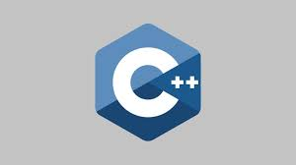


There are many different coding options.

Slide 11
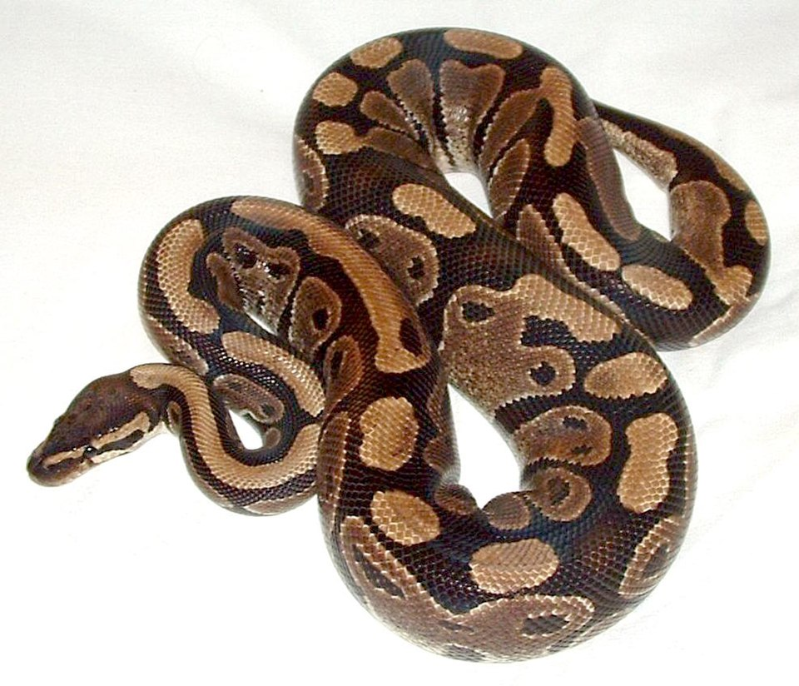
Why are we using Python over other languages?
Easy to Learn
Easy to Read
Lots of use and support

Slide 12
Coding in Python

Slide 13
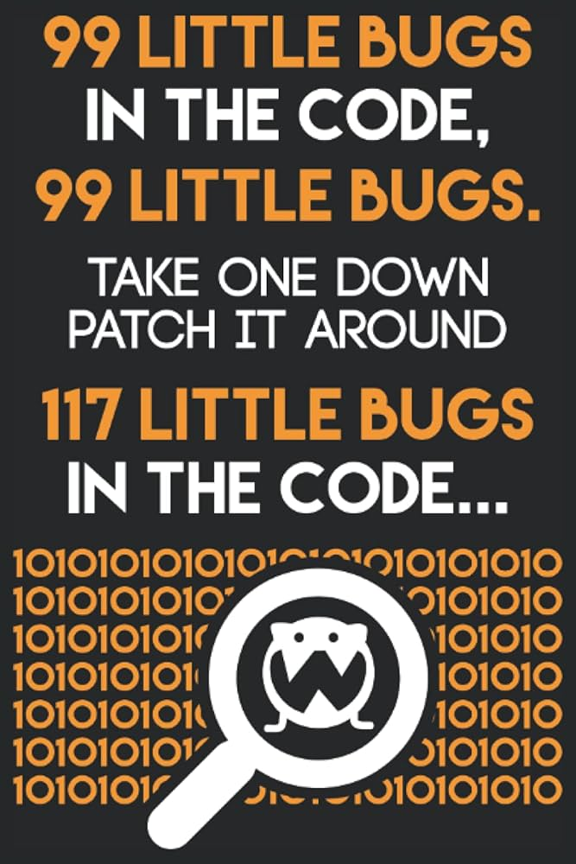
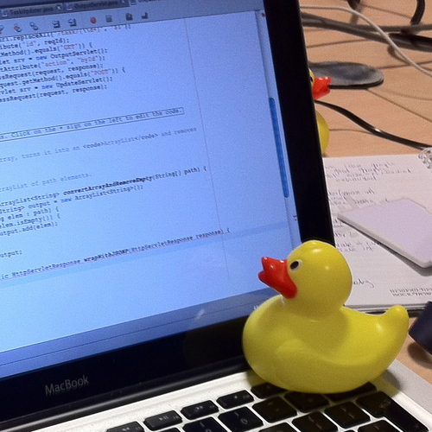
Debugging is the process of fixing your code, and it is the most important skill to have.
From Tom Eastwood’s Programmer Journal

Slide 14
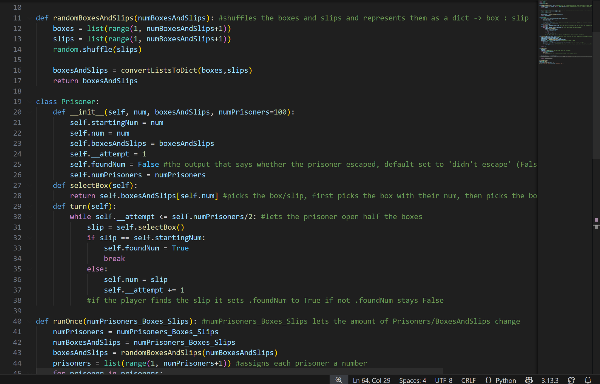
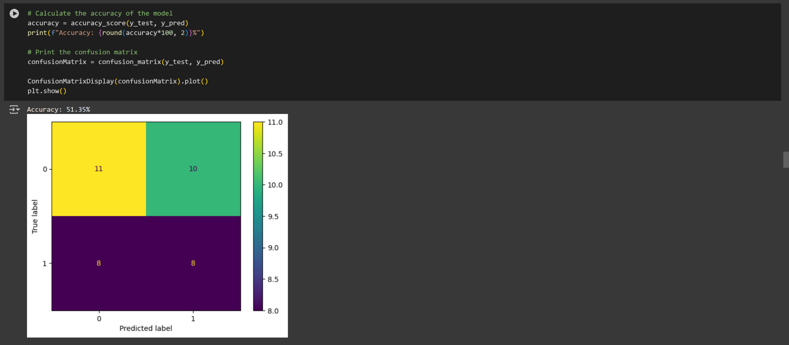
There are two main ways to code in Python, we will be using the Notebook style.
Standard .py File
Notebook/.ipynb File

Slide 15

Notebook Setup
Google Colab - A google based Python editor that uses the notebook style

